Slide 1
Violence Against Women Act
Campus Climate Webinar
April 28, 2022
3-4 pm ET

Slide 2
Introduction
Goals
Learning Outcomes
Speaker Introductions

Slide 3
Setting the Context
Violence Against Women Legislation

Slide 4
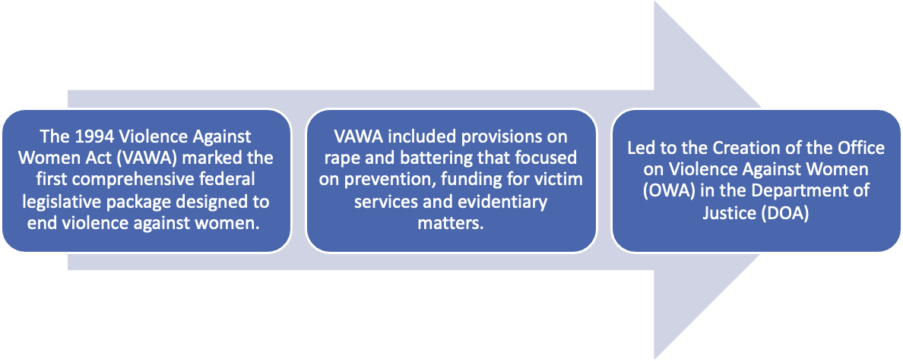
VAWA Legislative History — 1994

Slide 5
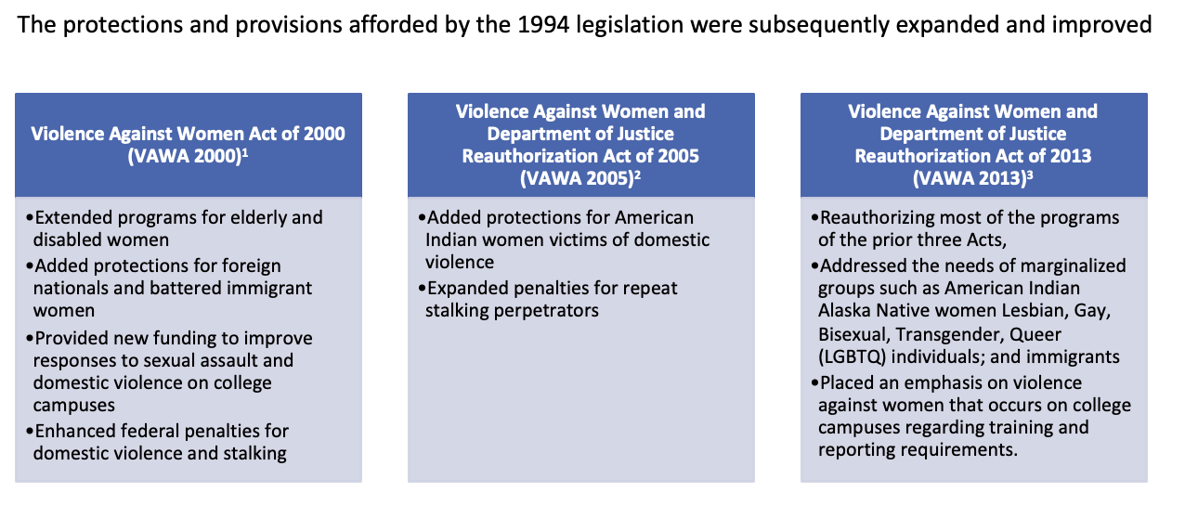
VAWA Legislative History — 2000-2013

Slide 6
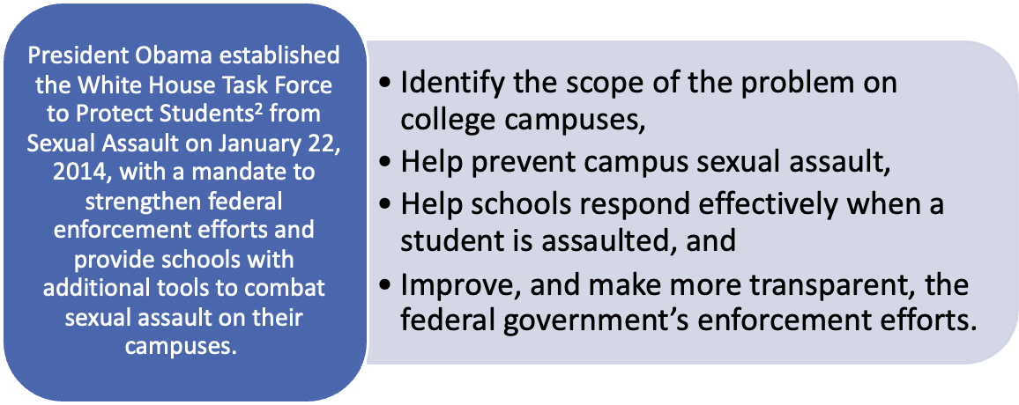
Not Alone¹— 2014

Slide 7
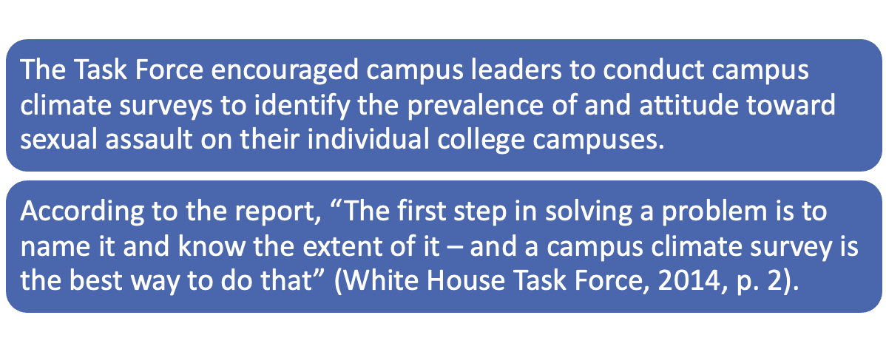
Conduct a Climate Survey

Slide 8
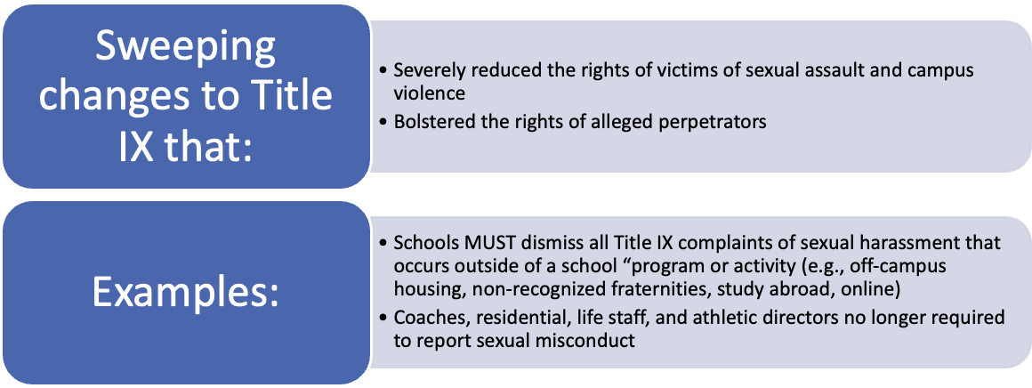
DeVos Rescinds Obama-era Guidance — 2017

Slide 9
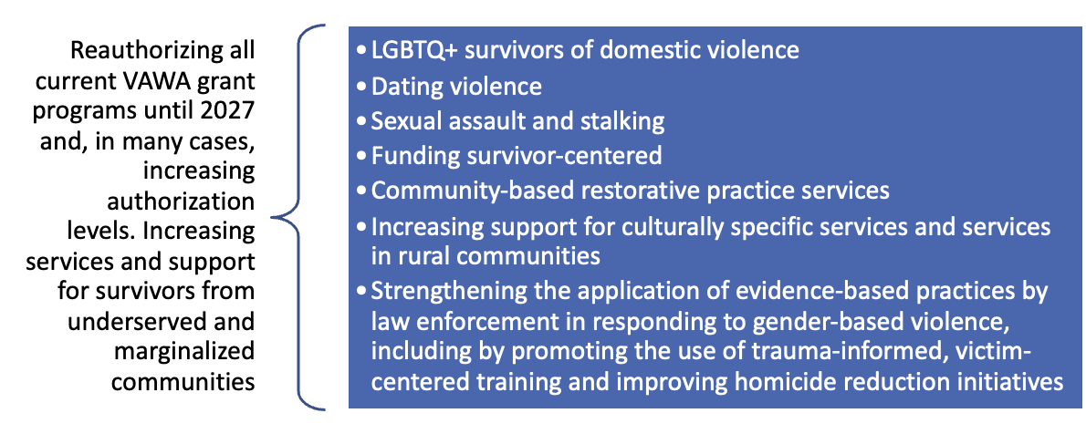
The Violence Against Women Act
Reauthorization Act of 2022 (VAWA)

Slide 10
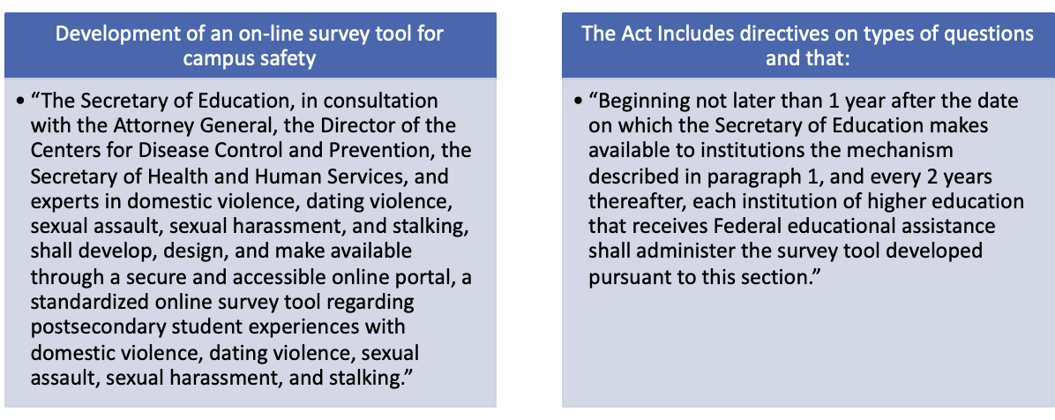
Consolidated Appropriations Act of 2022¹

Slide 11
Setting the Context
By The Numbers

Slide 12
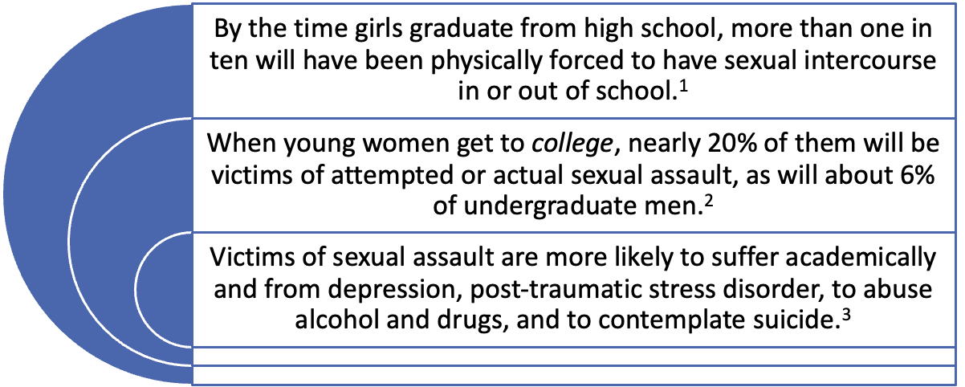
Unwanted Sexual Misconduct Secondary
and Post-Secondary — 2011

Slide 13
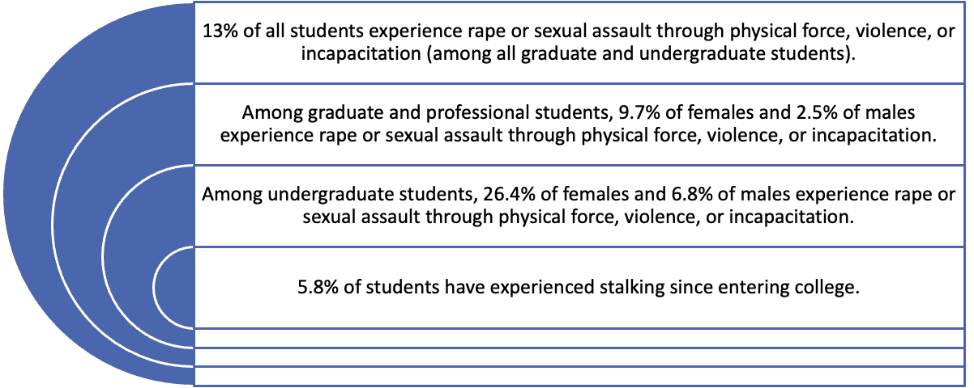
RAINN¹ — 2020

Slide 14
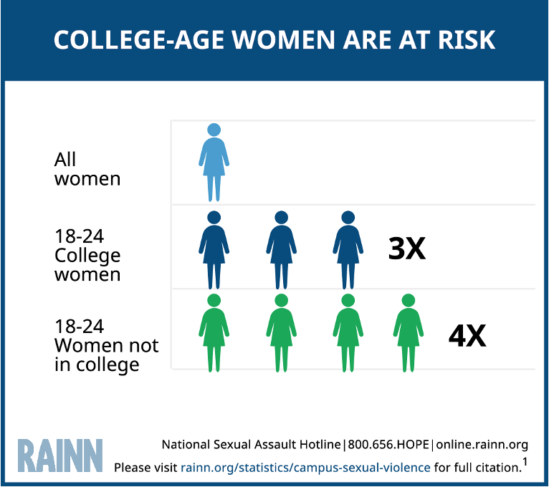

Slide 15
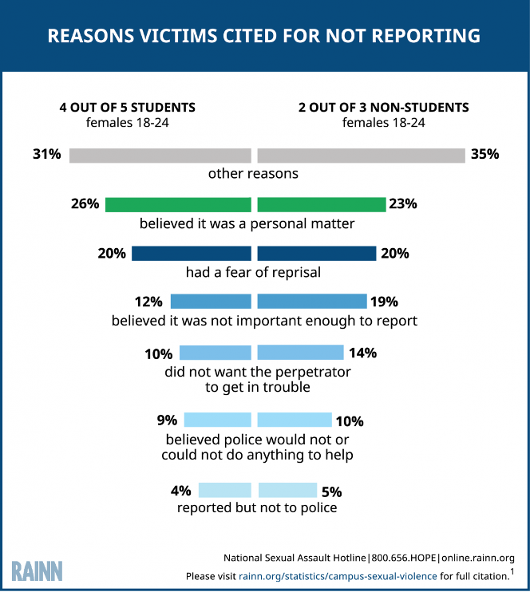

Slide 16
Selected Summary Findings: 2018—2021
Undergraduate Students (51 institutions) | Unwanted Sexual Conduct¹ | Overall Comfort with Campus Climate | Experienced Harassment | Seriously Considered Leaving
Liberal Arts Institutions | 11% | 76% | 20% | 34%
Jesuit Institutions | 10% | 77% | 19% | 31%
Comprehensive Institutions | 8% | 81% | 16% | 26%
Research I Institutions | 8% | 77% | 18% | 25%
Community Colleges | 9% | 88% | 14% | 16%

Slide 17
Setting the Context
Be Cognizant of Difference

Slide 18
ACHA-National College Health Assessment
 | Straight | Queer-Spectrum
Sexually Touched | 6.8% | 14.5%
Attempted Penetration | 2.7% | 6.5%
Completed Penetration | 1.7% | 4.1%
Any of the Above | 7.4% | 15.5%
 | Cisgender | Trans-Spectrum
Sexually Touched | 7.6% | 13.7%
Attempted Penetration | 3.1% | 5.8%
Completed Penetration | 1.9% | 4.5%
Any of the Above | 8.2% | 14.8%
LGBTQ
Sexual
Violence

Slide 19
ACHA-National College Health Assessment
 | Straight | Queer-Spectrum
Emotionally Abusive Relationship | 7.7% | 12.6%
Physically Abusive Relationship | 1.6% | 2.9%
Sexually Abusive Relationship | 1.5% | 3.6%
Any Abusive Relationship | 8.4% | 14.1%
 | Cisgender | Trans-Spectrum
Emotionally Abusive Relationship | 8.3% | 13.9%
Physically Abusive Relationship | 1.8% | 3.5%
Sexually Abusive Relationship | 1.8% | 4.6%
Any Abusive Relationship | 9.0% | 15.2%
LGBTQ
Relationship
Violence

Slide 20
What Is Campus Climate?
Attitudes of Students, Faculty, Staff, & Administrators
Students’ Perceptions of the Institution
Risk and Protective Factors Related to Misconduct
Pascarella & Terenzini (2005)

Slide 21
“
“
[A] school that is willing to get an accurate assessment of sexual assault on its campus is one that’s taking the problem – and the solution – seriously.
White House Task Force
to Protect Students from Sexual Assault (2014)

Slide 22
Motivation
Recent Legislation
Media Coverage
Groundbreaking Research

Slide 23
Motivation
Recent Legislation
Media Coverage
Groundbreaking Research
Student Advocacy

Slide 24
Motivation
Recent Legislation
Media Coverage
Groundbreaking Research
Student Advocacy
Dedicated Administrators

Slide 25
The Past Decade
Hundreds of campuses have assessed sexual misconduct climate
Each institution is different
Climate survey is just the beginning
Campus action plans should be carefully considered and implemented

Slide 26
Some Existing Survey Tools
AAU
ARC3
CATS (University of Kentucky)
White House Task Force

Slide 27
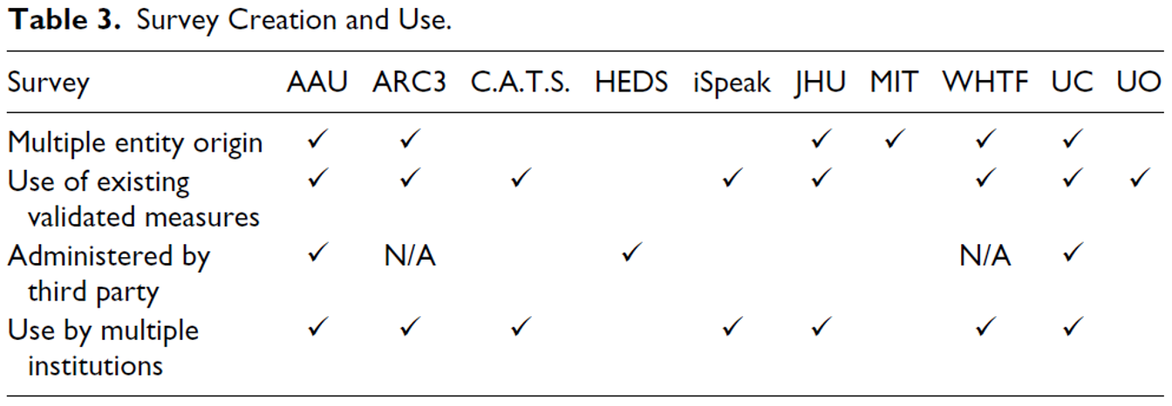
Some Existing Survey Tools
Wood, Sully, Kammer-Kerwick, Follingstad, & Busch-Armendariz (2017)

Slide 28
ARC3 Student Survey Modules
Possible Outcomes
Alcohol Use
Peer Norms
Perceptions of Campus Climate
Regarding Sexual Misconduct
Sexual Harassment by Faculty/Staff
Sexual Harassment by Students
Stalking Victimization
Dating Violence Victimization
Sexual Violence Victimization
Institutional Responses
Peer Responses
Affirmative Consent
Bystander Intervention
Campus Safety
Demographics
Additional Information

Slide 29
ARC3 Student Survey Modules
Demographics
Possible Outcomes
Sexual Harassment
Stalking Victimization
Dating Violence Victimization
Sexual Violence Victimization
Reporting Experiences
Institutional Responses
Economic Impact
Affirmative Consent
Bystander Efficacy
Campus Safety
Additional Demographics
Additional Information

Slide 30
Considerations
Inclusiveness, mutual respect, and collaboration
A transparent process
Ensuring independence and integrity in research

Slide 31
Considerations
Use of the best scientific evidence as the foundation of the survey
Sensitivity to the unique issues faced by various diverse populations
Civil rights approach grounded in Title IX

Slide 32
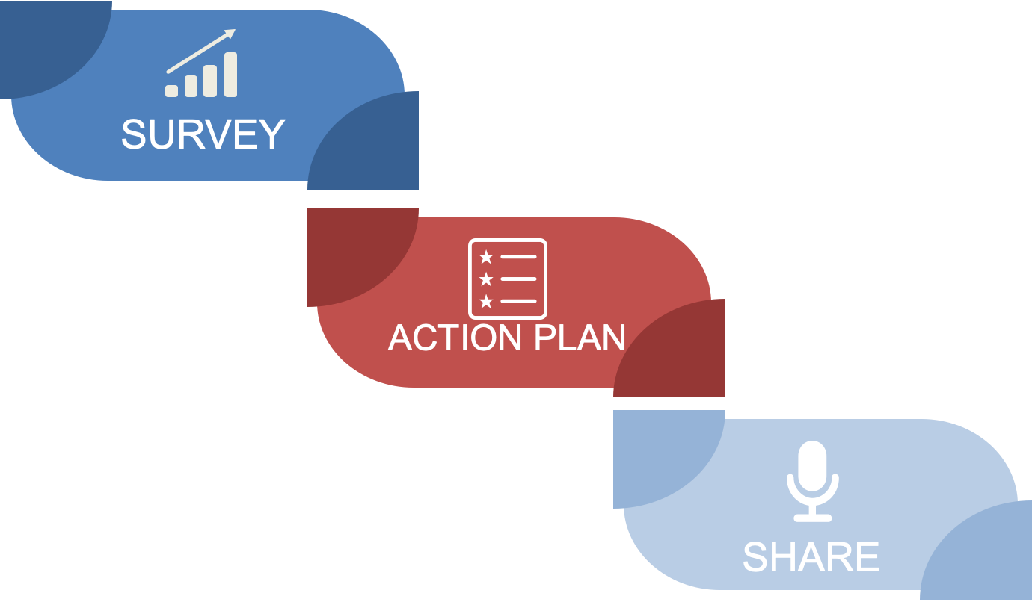
The “Now What?” Moment
Notes:
During the first wave of climate surveys, many campuses viewed them as an endpoint; In line with the White House Task Force statement: a strong demonstration that they take campus sexual misconduct seriously and are ready to do something about it. So, it maybe felt like a victory or an endpoint.
The problem with this is that the climate survey is not an endpoint, it’s a new beginning. It’s a new beginning stemming from an informed perspective regarding the prevalence of misconduct occurring on a campus, and the issues surrounding that misconduct

Slide 33
So… What Now?

Slide 34
Take data & formulate a plan to prevent sexual harrassment and violence
Prevention work is squarely within Title IX
…but you don’t need to do it alone!
Institution-wide coalitions/Coordinated Community Response Team (UC-Berkeley, U of Michigan)

Slide 35
How to Create a Prevention Action Plan
What story is the data telling you about sexual harrassment and violence in your community?
What correlative factors of sexual harassment/violence can you identify?
Elevated victimization rates in specific populations
Alcohol and other drug use
Consent/coercion rates
Student sexual harassment rates
What knowledge gaps are there? What attitudes and beliefs need to change?
Look at investment numbers—do folks feel like this is important to them, like they can make a difference? Who does, who doesn’t?
Distill down to major takeaways of what fuels the persistence of sexual harrassment and violence
Notes:
You will have a giant hole in this data from not being able to turn around and ask why. Just know this now. And that finding “the reason why” is also not going to be coming out of this survey, either: just correlative factors.

Slide 36
Data Synthesis & Identify Action Areas
SH/SV Climate Survey
Other surveys
Additional DEI climate surveys
ACHA
Healthy Minds
CIRP
NSSE
Internal assessment
Internal reporting data
Academic research
Formulate
Areas for
Action
But also: What do you not know?

Slide 37
Data Synthesis & Identify Action Areas
Identify those multiple large areas for action and then the specific items/programs/efforts to address them
Mix actions targeted at general community with specific populations
Not all actions need to be active (i.e., mandatory); embrace voluntary and passive actions and mixed-education methods
Establish assessment metrics to evaluate effectiveness—as well as gathering information you don’t know

Slide 38
What You Can Do Now
Build your team, build your survey administration strategy
Review use of internal reporting data
Take your current data and start synthesis
The survey isn’t about measuring your problem; it’s measuring your progress.

Slide 39
Questions?

Slide 40
References
Aday, T. (2015). The effectiveness of the Violence Against Women Act (VAWA) in creating system-level change. SPNHA Review, 11(1), 3.
Cantor, D., et.. al., (2020). Association of American Universities (AAU), Report on the AAU Campus Climate Survey on Sexual Assault and Sexual Misconduct (January 17, 2020).
Clark, M. B. (2007). Falling through the cracks: The impact of VAWA 2005’s unfinished business on immigrant victims of domestic violence. University of Maryland Law Journal of Race, Religion, Gender & Class, 7, 37.
Eaton, D. K., et.al., Youth Risk Behavior Surveillance-united States 2009, Morbidity and Mortality Weekly Report.
Christopher P. Krebs Et Al., The Campus Sexual Assault Study Final Report xiii, 5-5 (Nat’l. Criminal Justice Reference Service, Oct. 2007), available at http://www.ncjrs.gov/pdffiles1/nij/grants/221153.pdf.
Laney, G. P. (2010). Violence Against Women Act: History and federal funding. Cornell University ILR School.
Modi, M. N., Palmer, S., & Armstrong, A. (2014). The role of Violence Against Women Act in addressing intimate partner violence: A public health issue. Journal of Women’s Health, 23(3), 253–259.
Simone Robers, Et Al., Indicators Of School Crime And Safety 104 (U.S. Department of Education & U.S. Department of Justice, Nov. 2010), available at http://nces.ed.gov/pubs2011/2011002.pdf.
Sacco, L. N. (2015). The Violence Against Women Act: Overview, legislation and federal funding.
Walz, K. E., & McLaughlin, M. (2014). Collaborative approach to housing under the Violence Against Women Reauthorization Act of 2013. Clearinghouse Review, 48, 143.

